Slide 1


Real-Time Face Mask Detector
CSE 475
Machine Learning
Submitted to:
Dr. Md Forhad Rabbi
Associate Professor, Dept. of CSE, SUST
Submitted by:
Md Nahid Reza Shovo
Reg No. : 2016331008

Slide 2

Introduction
Results
01
03
Methodology
Discussion
02
04
Outline
Importance of this project and our goal
Final output, accuracy, data loss...
Dependencies, datasets and methods of the model
How can we use it and how to improve it?

Slide 3

Introduction
01
Importance of this project and our goal

Slide 4

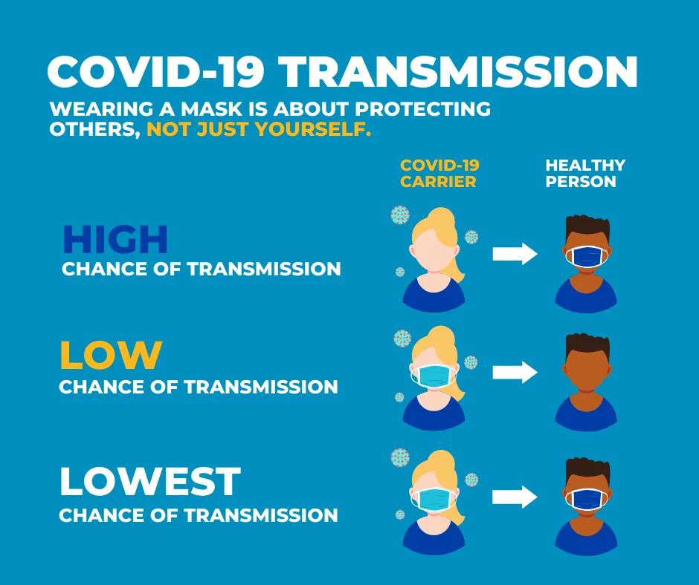
Why should we wear a face mask?
Airborne transmission by droplets and aerosols is important for the spread of viruses like COVID-19.
Masks are a key measure to suppress transmission and save lives.

Slide 5
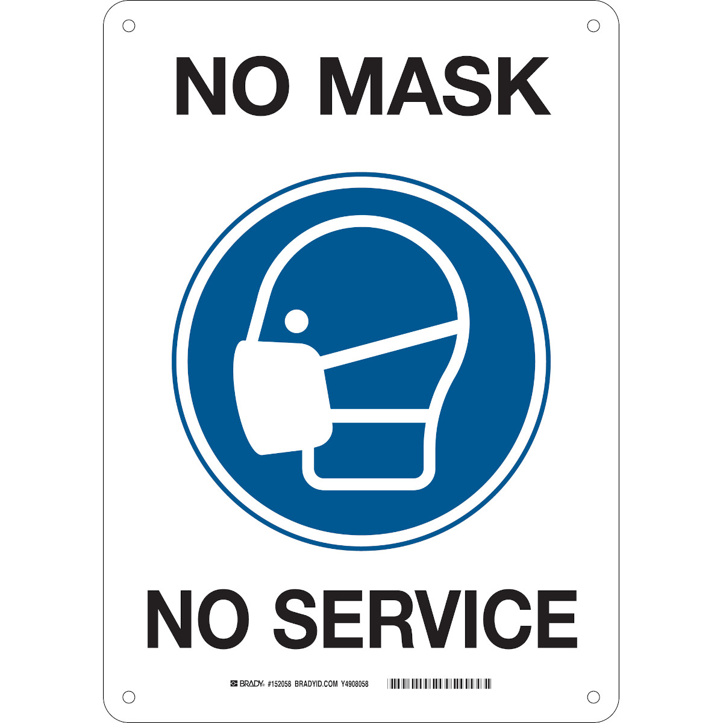
Policy of Bangladesh Govt. About Face Mack
The Bangladesh government has decided that no service will be provided to people who don’t wear mask.

Slide 6
OUR Motivation
We want to develop a system using machine learning algorithms that will automatically detect people who don’t wear a face mask with the help of the footage of a camera.

Slide 7
Methodology
02
Dependencies, datasets and methods of the model

Slide 8
Dependencies
We need following requirements:
Jupyter Notebook
Tensorflow
Keras
Imutils
Numpy
Opencv
Matplotlib
Scipy

Slide 9
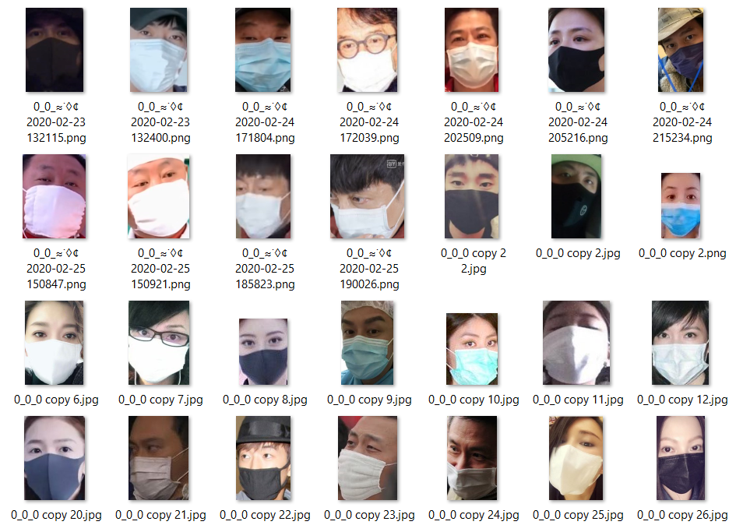
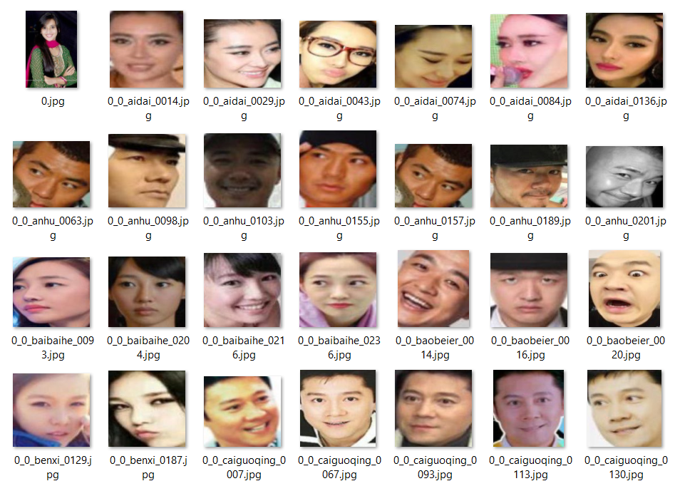
Dataset
Sample Dataset
Collected form: Dataset Link
Consists of 3853 images
With Mask: 1915
Without Mask: 1918
File Size: 130 MB
80%(3066) images used for training
20%(767) images used for testing

Slide 10
Procedures
We will build our system in 2 phases:
A Mask Detector Model with the help of dataset
Use model in real time camera

Slide 11
Mask Detector Model
01
02
03
04
05
06
Data Pre-processing:
Converts all images into numpy array
Split the dataset into into training and testing data
Construct an image generator that will create multiple image from a single image by changing features
Build our model with the help of MobleNetV2(a CNN architecture).
Train our model with training dataset and finally test it with testing dataset
Calculate accuracy and value loss for our model.

Slide 12
Detect Mask in Real Time Camera
01
02
03
04
05
06
For face detection we will use a model based on Deep Neural Network module of OpenCv library
Load the Mask Detector Model
Loading Camera Using VideoStream module from imutils.video library
Grab the frame from the threaded video stream and resize it. Each frame contains an image.
Using the face detection, mask detection model and the frame calculate the probability of wearing a mask.
Based on the prediction
display level(“Mask”, “No Mask”) with the probability.

Slide 13
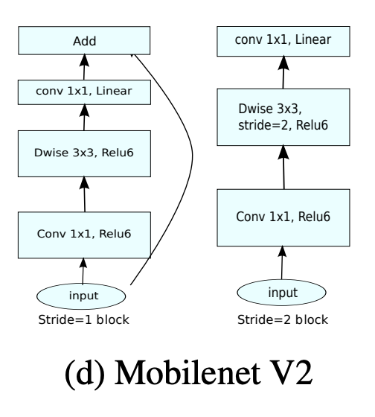
MobileNetV2
MobileNetV2 is a Convolutional Neural Network Architecture.
It is based on the Inverted Residual Structure.
Comes with tensorflow.keras.applications library.

Slide 14

Convolutional Neural Network
A Convolutional Neural Network (ConvNet/CNN) is a Deep Learning algorithm which can take in an input image, assign importance (learnable weights and biases) to various aspects/objects in the image and be able to differentiate one from the other.

Slide 15
Results
03
Final output, accuracy, data loss...

Slide 16
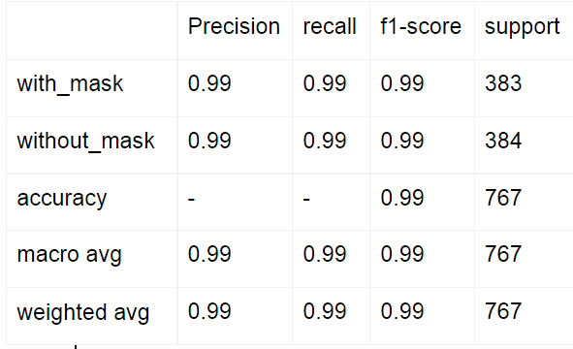
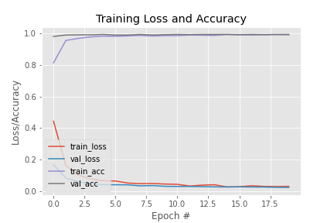
Mask Detector Model Performance

Slide 17
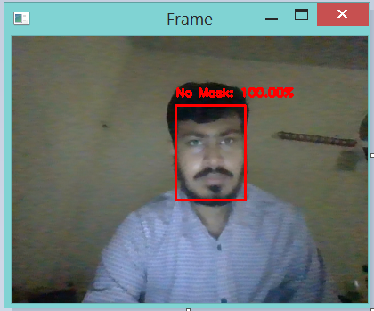
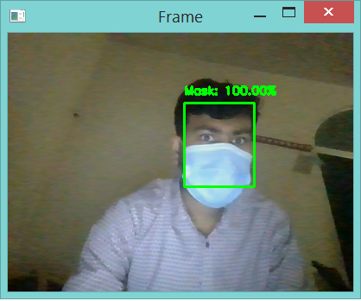
Detect Mask in Real Time Camera Performance

Slide 18
Discussion
04
How can we use it and how to improve it?

Slide 19
Discussion
The performance of
this model is very well.
Almost 99% accurate.
It can also use in security purpose like a person trying to enter in a building hiding his face.
Accuracy
Secondary Uses
Primary Uses
Improve Usability
It can be rapidly use in no mask, no service program.
Integrate the model with face recognition model, we can improve its usability.

Slide 20
THANKS!

